Slide 1
WELCOME

Slide 2
Course Overview
Topics
Regulations
Weather
Airspace
Airport operations
Radio communications
We can’t cover everything, but we’ll give you enough to know where you should ask more from your CFI or your own study
LET’s get started

Slide 3
Check Out the Materials
Rusty Pilots Resource Guide
Kneeboard sized and organized for use once you’re back in the cockpit!
Scenario Handout
Practice materials that you’ll use to complete our mission today
LET’s get started
Notes:
In the event there are not enough handouts to go around, see the two hidden slides with QR codes on them. Have attendees email RustyPilots@AOPA.org and we will mail them hard copies.
aopa.​org/rustypilotresourceguide
aopa.​org/rustypilotscenariohandout

Slide 4
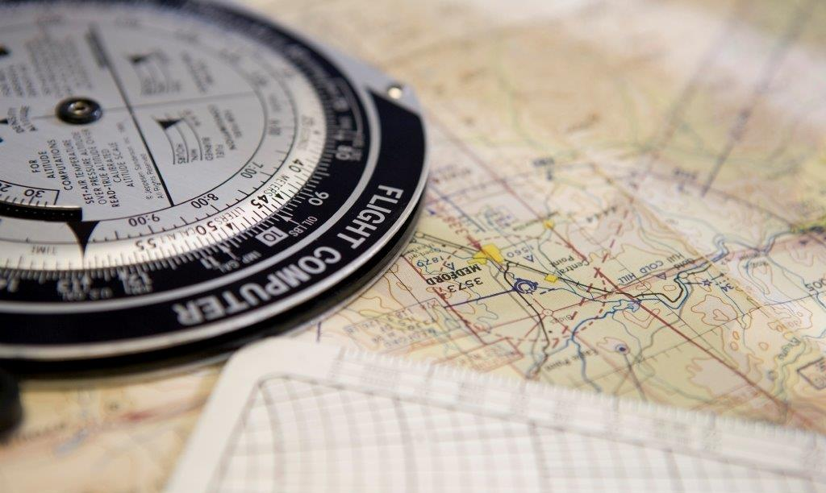
Pre-flight planning and preparation

Slide 5
SCENARIO: Taking the kids to Disney World for Mickey’s New Year’s Eve Party.
PRE-FLIGHT planning and PREPARATION

Slide 6
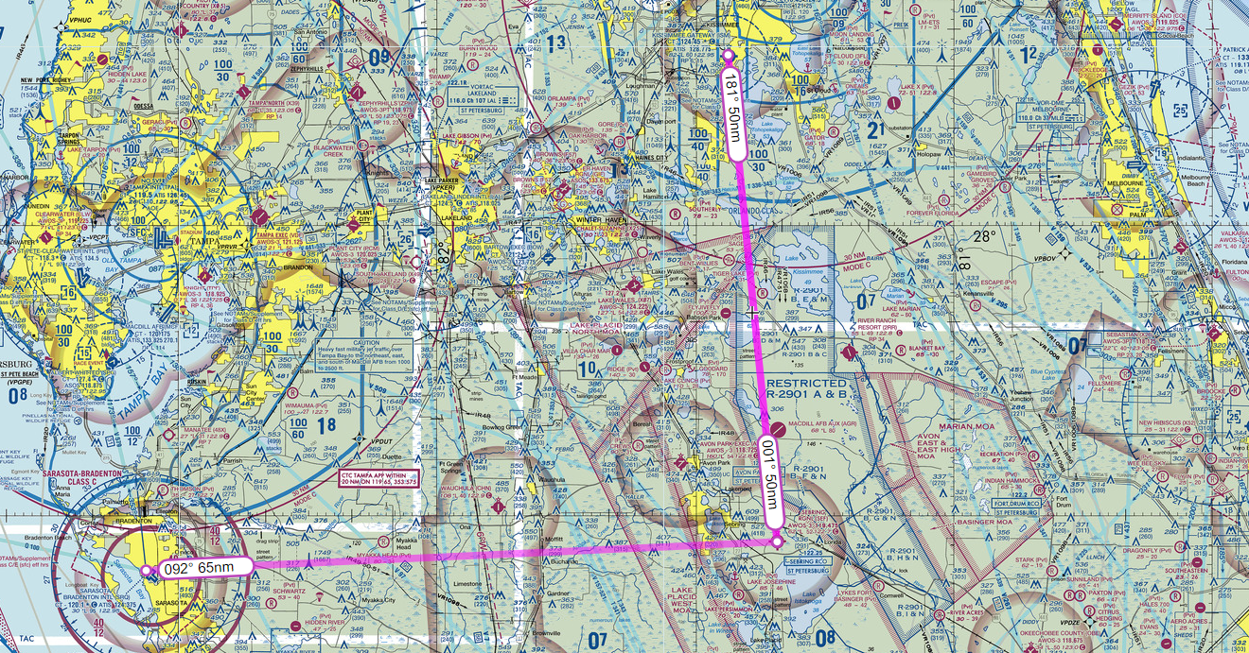
The Route
PRE-FLIGHT planning and PREPARATION

Slide 7
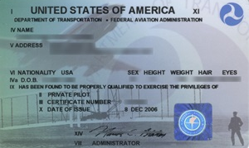
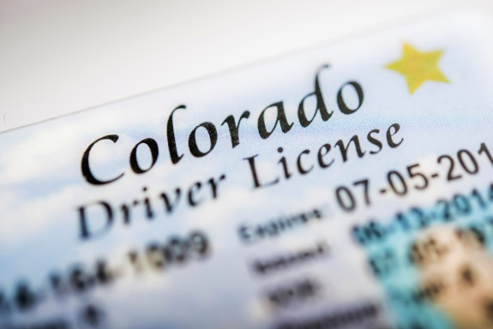
Wanted: Pilot In Command
What do you need to carry with you when you fly?
Flying with a Medical Certificate:
Plastic pilot certificate
Government issued photo ID
Medical certificate
Flying with BasicMed:
Plastic pilot certificate
Driver’s license (not just any Gov’t issued ID)
PRE-FLIGHT planning and PREPARATION
Notes:
61.53 (a) (1) No person who holds a medical certificate under part 67 may act as PIC if they know they have a medical condition that would make them unable to meet the requirements of a medical certificate.

Slide 8
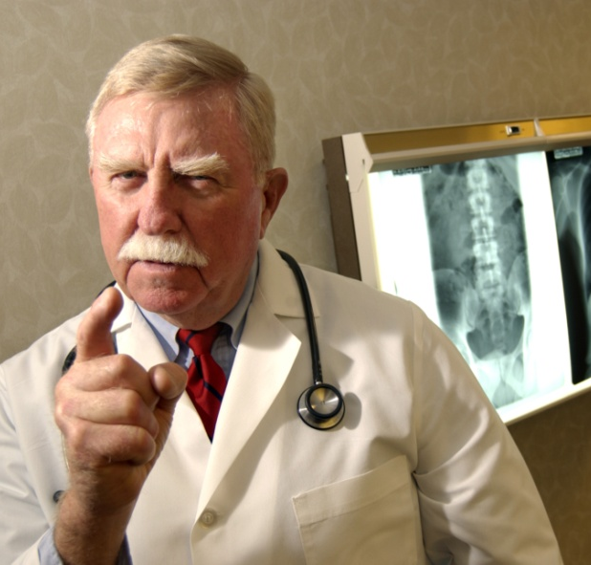
Ready for Flight? Part 1 “Medical Currency”
Is this pilot legal?
Age: 48
Today's date: Dec 31
Holds 3rd Class Medical Certificate
Last medical exam: Dec 15, two years ago
Refer to your Resource Guide to help you decide
PRE-FLIGHT planning and PREPARATION

Slide 9
Getting the Weather
Practice copying your ATIS
A
Calm
30.01
32 & 22
121.9
Departing a Class C Airport

Slide 10
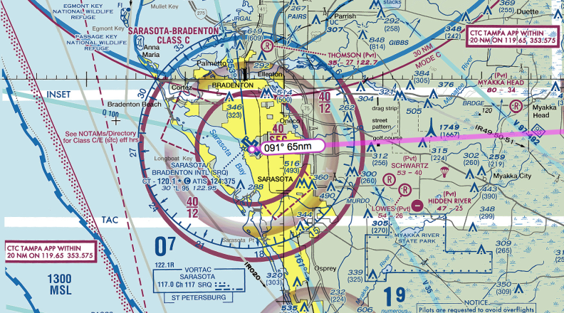
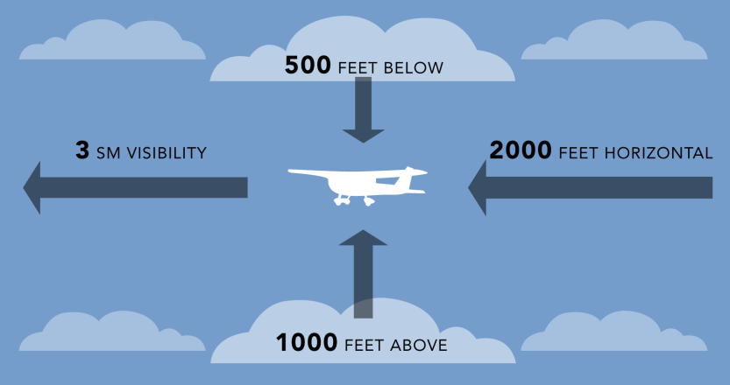
Class C Airspace Operations
Entry requirements and equipment
VFR weather minimums
Mnemonic: “3-152s”
CLASS C AIRSPACE

Slide 11
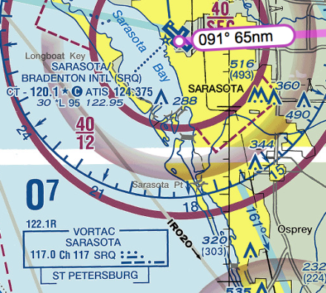
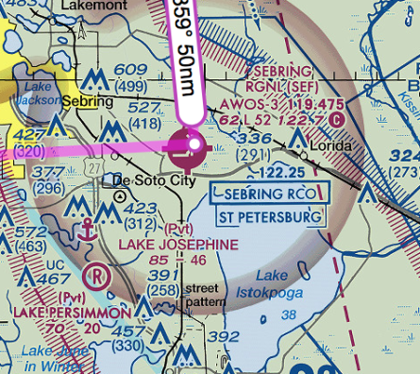
VFR Flight Plans: FSS Has Your Back
How to contact Flight Service
Universal FSS Freq: 122.2 (No more Flight Watch Freq.)
What to say?
Listen:
Refer to your Say It Right reference
CLASS C AIRSPACE

