Slide 1
July 21-24, Chicago, IL (USA)
IAOPA 28th WORLD ASSEMBLY

Slide 2
AOPA-NL 2015/16
Main issues of attention:
Membership Flying Clubs
Financial status
Cost of flying: tariffs licenses
Consulation platforms with Dutch governement and ATC
Most important focus issues 2015/16
First AOPA NL Fly in

Slide 3
Membership Flying Clubs
On request many flying clubs AOPA NL and with the approval of the general meeting changed its articles of association
The flying clubs supports the objectives of AOPA NL
The flying clubs can make use of the AOPA NL network
AOPA can support the interest of the flying clubs
Exchange of information
Flying clubs can make use of AOPA communication
Explicitly not the objective to replace the membership of individual members of the flying club
€ 1 per member of the club with a minimum of €85 and a maximum of €500.
Latest status dd July 2016: 11 Clubs

Slide 4
Membership and Financial status
Present: 1200 members
2015 clean up of “ghost members”
2015 income € 111k; costs € 73k; result € 38k

Slide 5
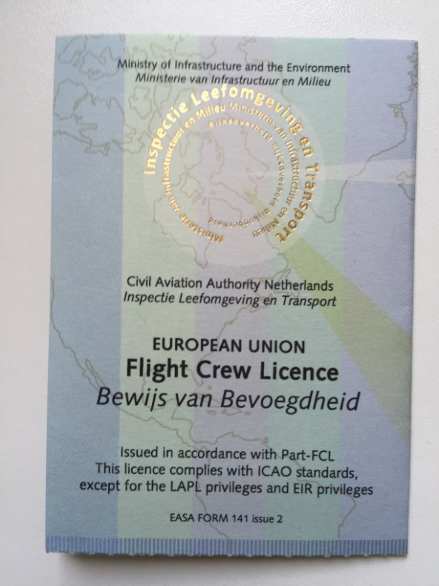
Cost of flying: tariffs licenses
Dutch tariffs (a.k.a. rip off):
Issue of initial PPL € 175 (NL 2008)
Issue of initial PPL € 600 (NL 2016)
Same in Germany € 60; Greece € 6; UK € 245
License Dutch Air Traffic Controller € 45
Driver’s license or passport € 50

Slide 6
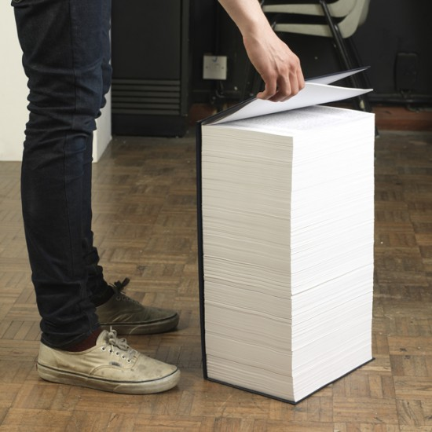
GA sector Government Consultations
GA Platform with Ministry of Transport + Inspection
Quarterly consulation with Dutch ATC (LVNL)
Strategisch Forum: Ministry of Transport and of Defence
User Consultation Licensing authority (KIWA)
Workinggroup Airspace Infringements: ATC, Military ATC and CAA/Inspection
User Consultations Dutch MET
State Safety Programme: GA Action Plan
“Future-proof” GA airfields

Slide 7
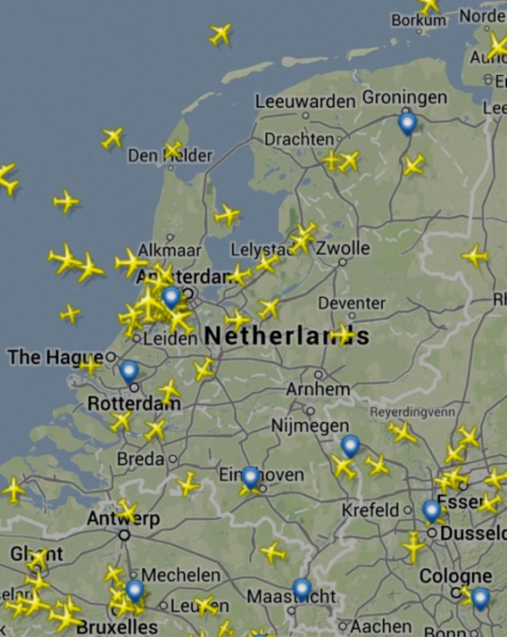
Most important/actual focus issues
Meetings Chairman AOPA with Chairmen Dutch Flying Clubs 2 x p/y
State Safety Programme/GA Actionplan
TGAL-rapport: future-proof GA airfields
Night VFR
Position Paper ‘Drones’
Paper chart allowed yes or no
Medical files: extremely long waiting periods
Input new GPS-procedures GA-field Budel
EU/EASA
National inplementation regulations (f.e. CB IR)
‘Introductory flights’
New regulations (OPS/NCO/NCC

Slide 8
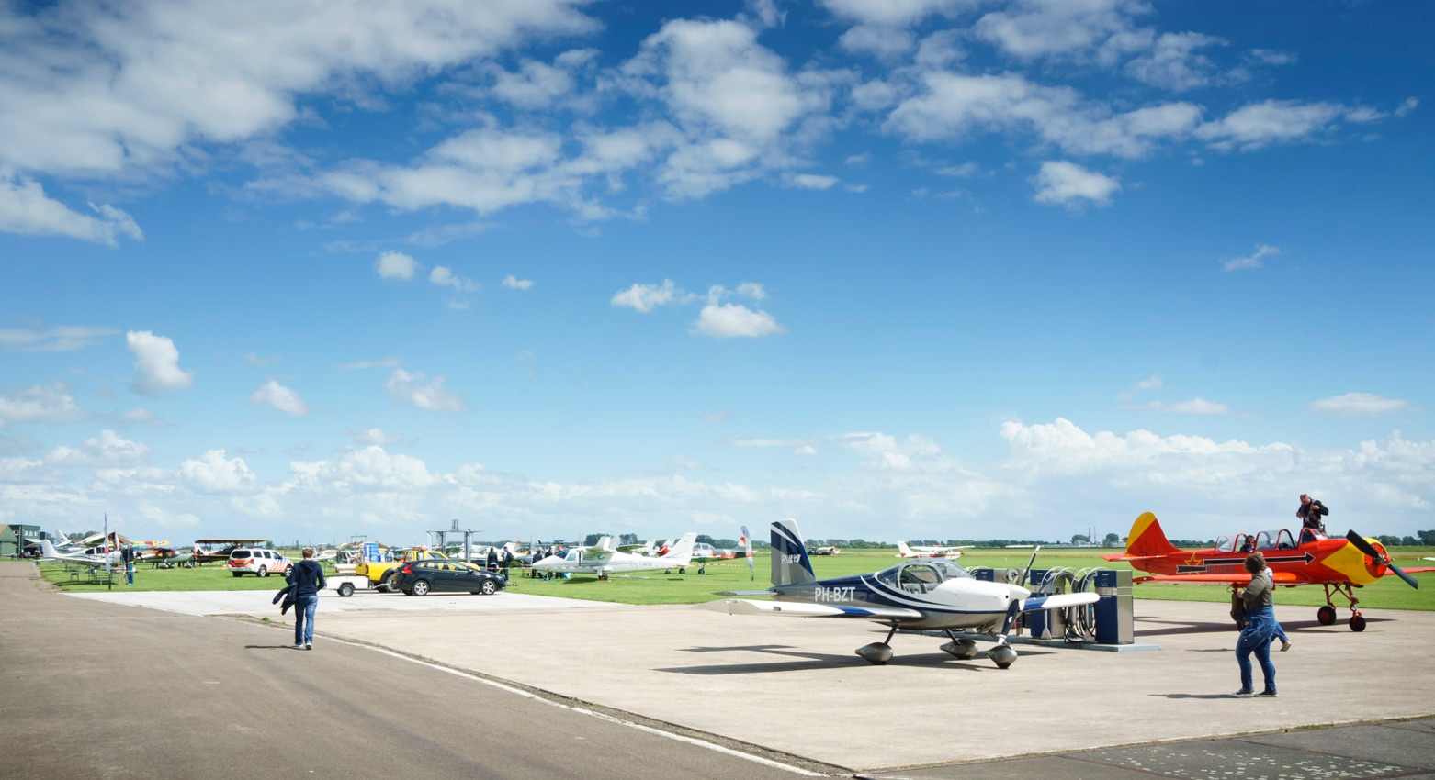
Our first fly-in!
80 planes
5 countries
300+ visitors
30kts headwind ;-)

Slide 9
Our first fly-in!
Dutch Experimental Association
Pilot Shops
Flying schools
Owner clubs
Inspiring keynotes
American style BBQ

Slide 10
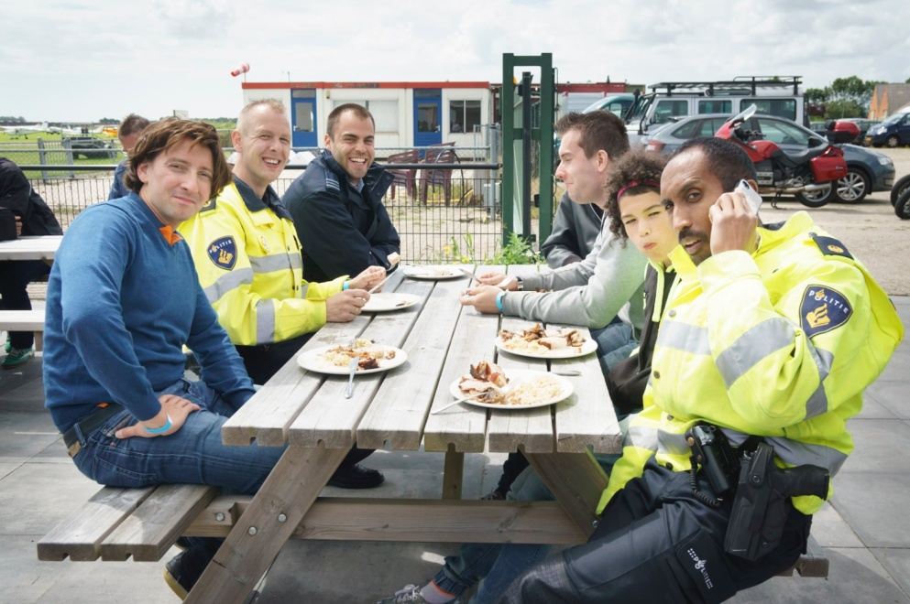
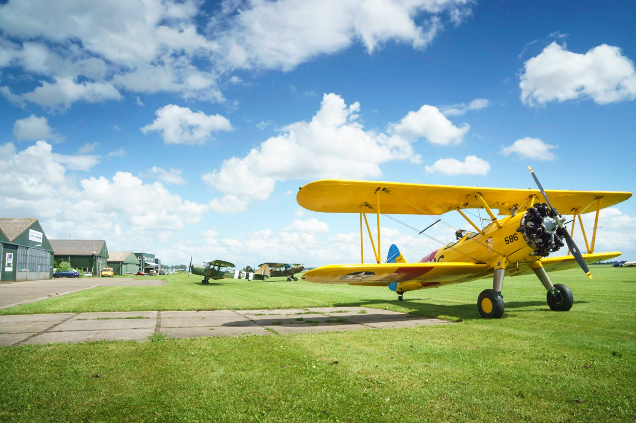
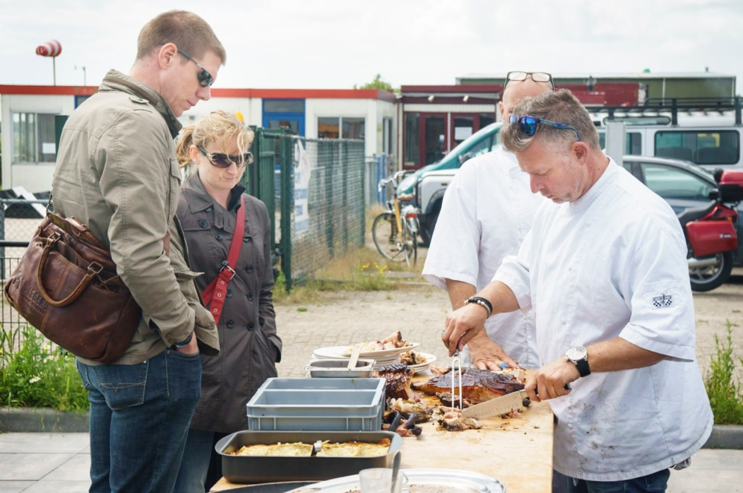
A fantastic success

